Slide 1
Image Compression using Quantization and Neural Networks with Noise Conditioning Ran Amir

Slide 2
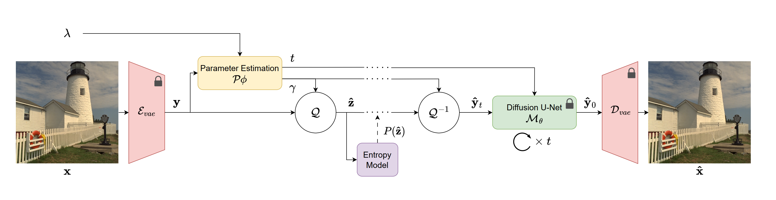
What some models do ?
Using some clever manipulation with diffusion models to correct non gaussian noise created by loss of precision and compression (quantization process)

Slide 3
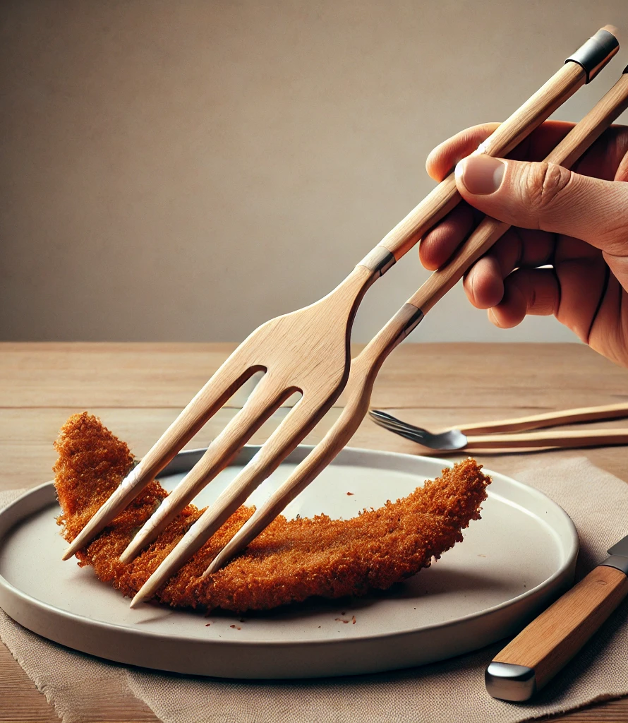
Seems like using sophisticated chopsticks for knife and fork job ?

Slide 4
Diffusion Models and Gaussian noise
It would have been great if introducing gaussian noise would result in a straightforward image compression.
But because of the random nature of gaussian, it’s actually the other way around.
We introduce non patterned data to the image.

Slide 5
Quantization and precision loss – effective compression
# Quantize function
def quantize_batch(latents, parameters):
parameters = parameters.view(-1, 1, 1, 1)
quantized_latents = (latents / (255 * parameters) + 0.5).clamp(0, 1)
#Decrease the original range from 0 to 255 to lower range,
#if parameter = 0.5 then any real number between 0 to 2 (since 255/127.5=2)
#Clamp, spread the values between 0 and 1 instead
quantized = (quantized_latents * 255.0 + 0.5).clamp(0, 255).type(torch.uint8)
#Multiply by 255 to reastblish a 0 to 255 range,
# and clamp between 0 and 255 as integers
#The result is loss of precision by less unique values,
#effectively compressing the image with lossy compression
quantized = quantized.float() / 127.5 - 1
# Converts the quantized integers to floating-point numbers in the range [-1, 1]
return quantized

Slide 6
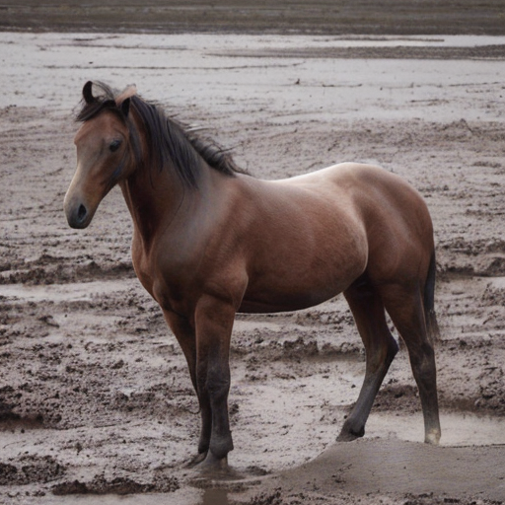
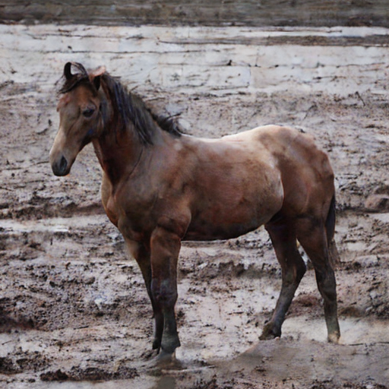
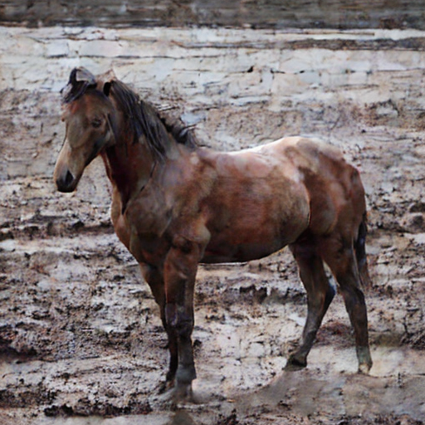
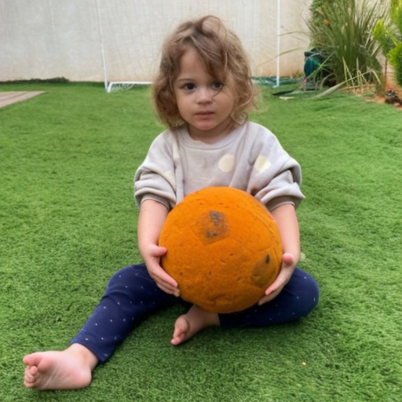
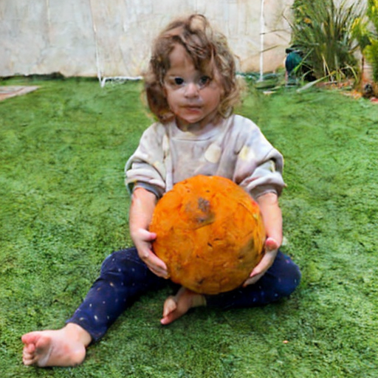
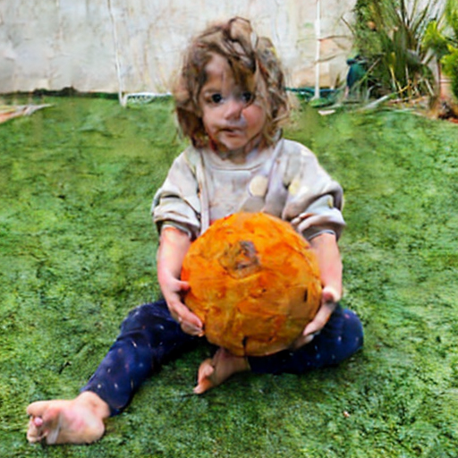
Can we imagine the effect for a given parameter ?
Original VAE compression
0.7 quantization parameter
0.9 quantization parameter
There are some potential patterns

Slide 7
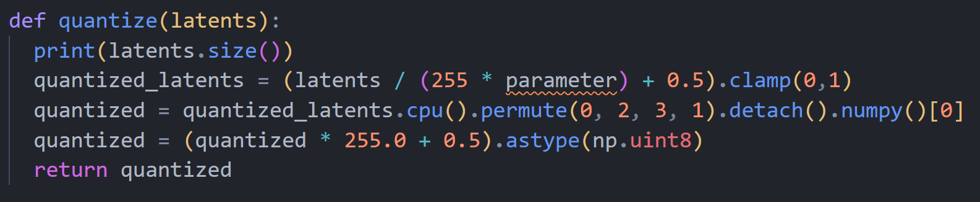
The Goal
Quantization greatly reduce the storage size of an image file compressed with VAE in the numbers of 60KB to 9KB with parameter=0.18, while sacrificing some quality. Achieving much lower bpp of about 0.3, from 0.9 for the VAE version.
In order to compete with the other paper metrics, we read, we need a method that reduce the file size to 0.3bpp and below and achieve competitive PSNR results.

Slide 8
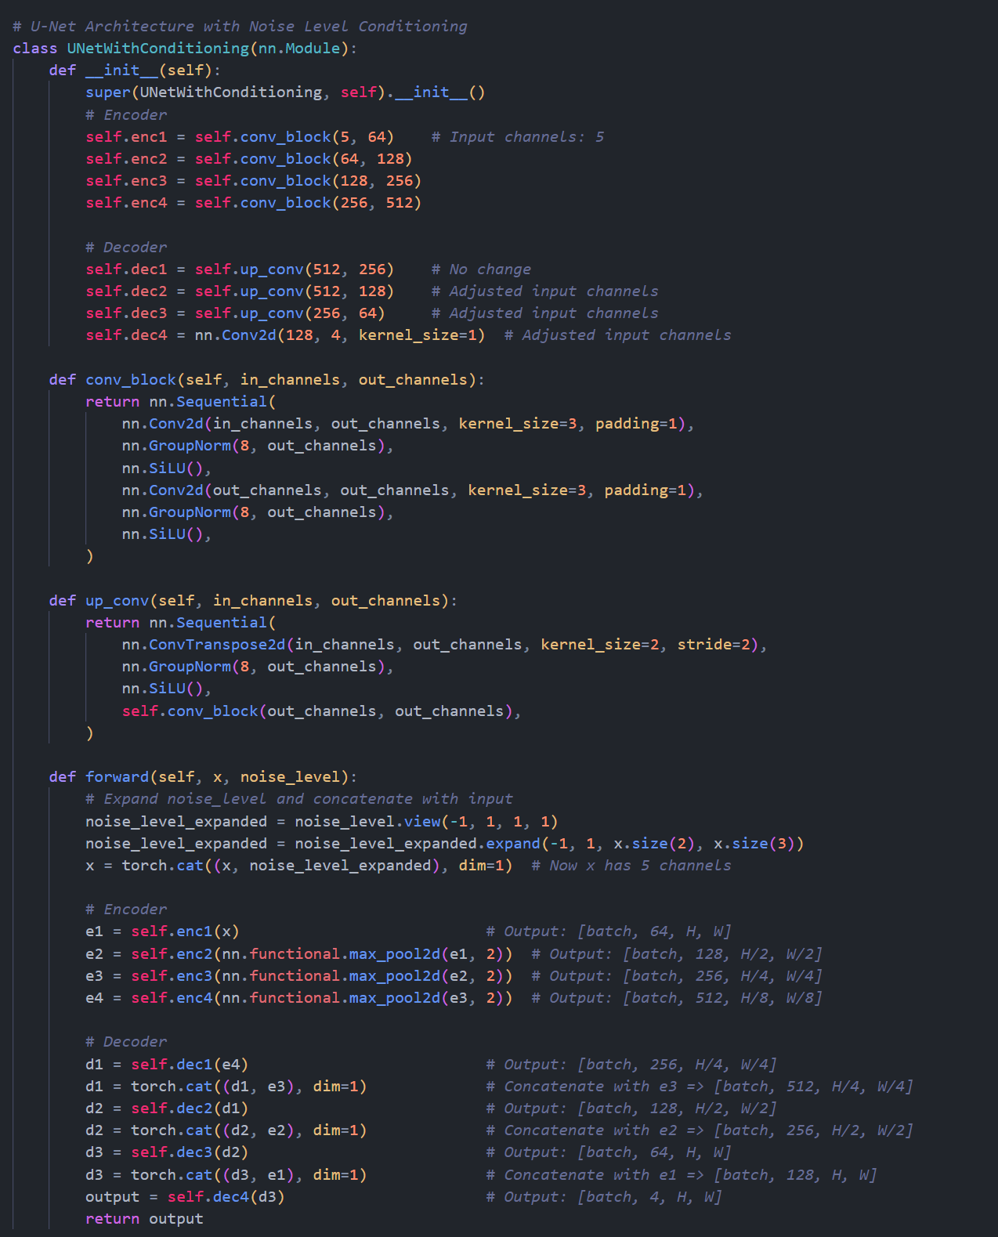
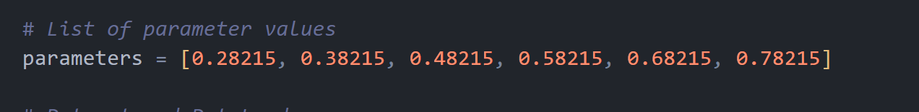
New Model
Using a U-Net neural network with noise conditioning (somewhat inspired by diffusion models) that was trained on photos from the COCO dataset resized and centered cropped to 256x256.
The new model was able to reach good PSNR and SSIM results in the CLIC 2022 dataset in comparison to the Disney paper.
The learning was conditioned on different “Parameter” values referred to in the model as “noise_levels”.

Slide 9
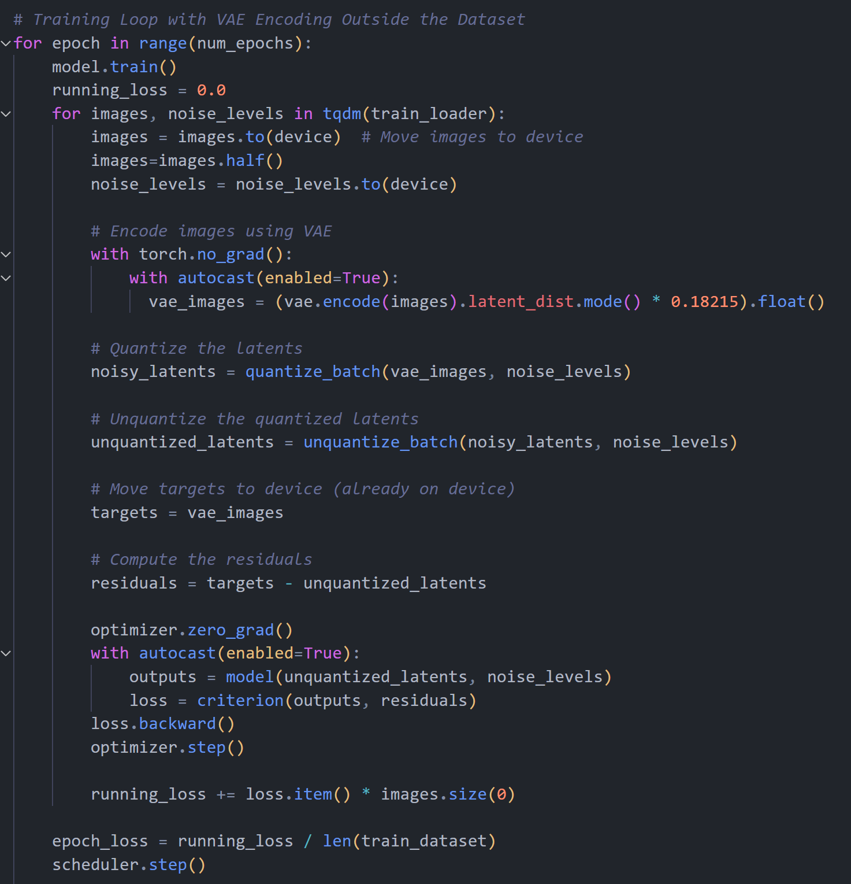
Predict the residual tensor
The model training is built to predict the residual tensor which is the difference between then the image tensor before quantization (VAE image) and the tensor after quantization and un-quantization process.
For each image, the model have learned how various types of “Parameter” value effects the resulted image tensor.
The model uses the AdamW optimizer, MSELoss, and CosineAnnealingWarmRestarts scheduler which adjusts the learning rate during the epoch progress.

Slide 10
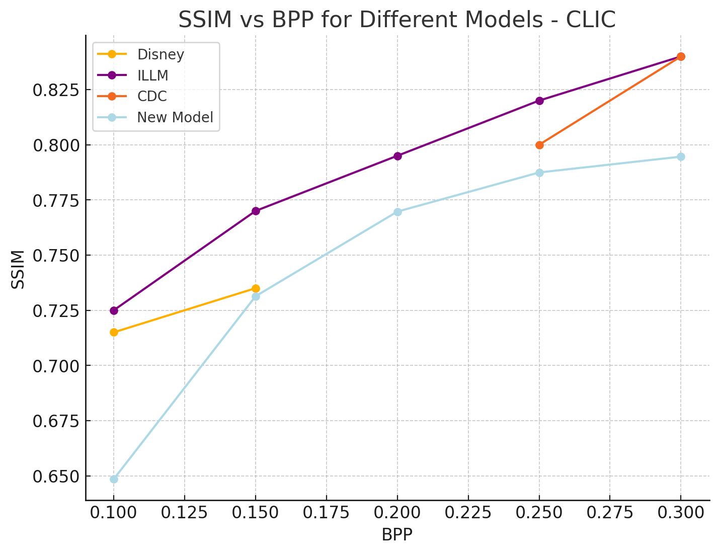
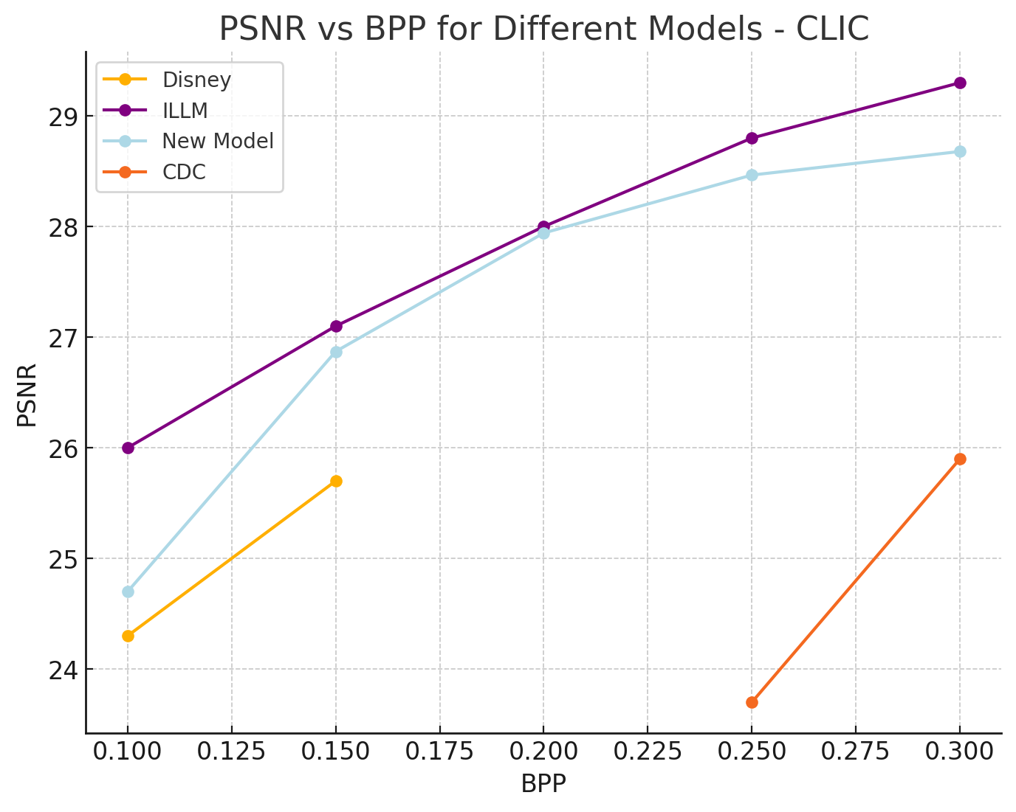
Initial Results
SSIM – Structural Similarity Index Measure
PSNR - Peak Signal to Noise Ratio

Slide 11
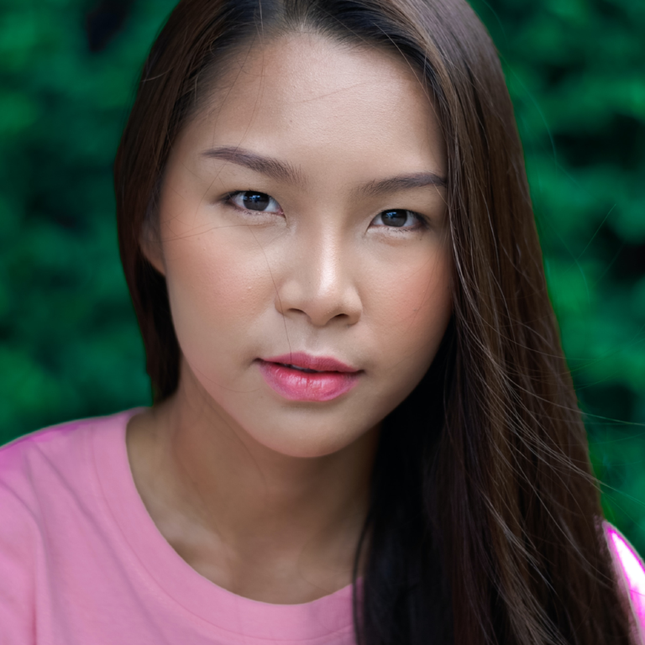


Initial Results
VAE compression PSNR: 29 DB BPP:0.9
Model compression PSNR: 28 DB BPP:0.3
Pure Quantization PSNR: 27 DB BPP:0.3

Slide 12
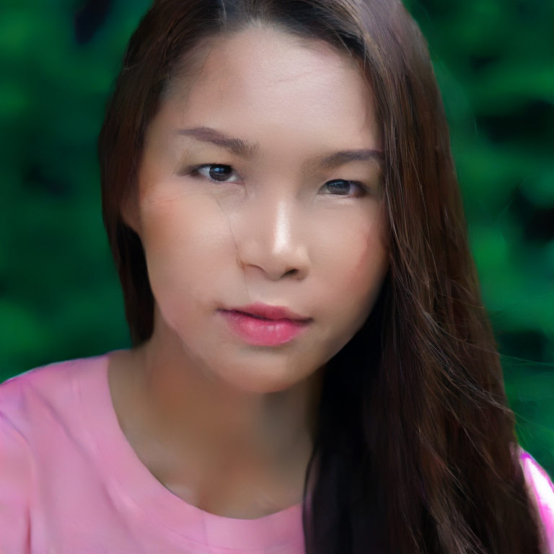
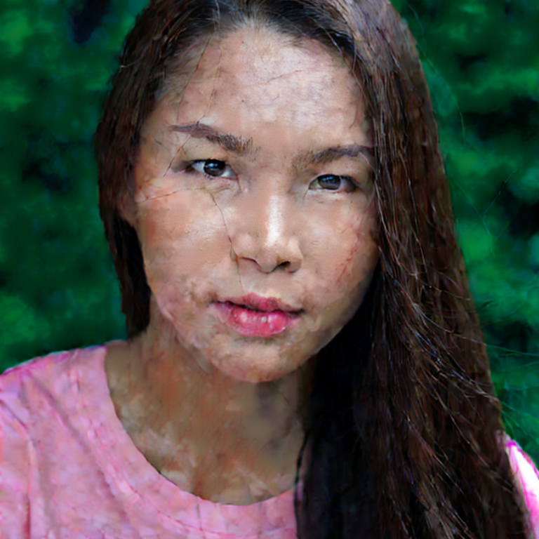
Initial Results
VAE compression PSNR: 29 DB BPP:0.9
Model compression PSNR: 24.6 DB BPP:0.1
Pure Quantization PSNR: 22.6 DB BPP:0.1

Slide 13
General Model Flow
Predicted Residual Tensor
Ground truth image
Run Neural Network Conditioned on “Parameter”
Sum The Tensors
Reconstructed Tensor
Encode
VAE Latents
Unquantized Latents
Storage Operation
Quantify the VAE latents
with a chosen Parameter, reaching various bpp levels.
Compress with Brotli to a binary file
Quantified Tensor
Compressed data.
4.7 KB from 241KB of the Ground Truth, for a sample reference.

Slide 14
Noise Maps for compression

Slide 15
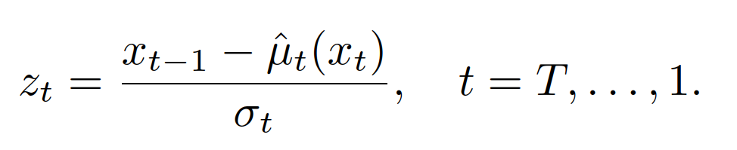
Expectation –
Using descriptive text
of the image
Possible Behavior In Practice –
The text making a different path,
while not necessarily minimizing z
Regular Behavior
Z1
Z1
Z1
Z2
Z2
Z2
The model interpretation of the text may not align with the ground truth. Similarly to how two similar images in concept, could look very differently in real life.

Slide 16
Noise Maps (zs) Characteristic - Why it might not work
Size and Complexity: In the standard diffusion process, there are 64 noise maps, each the size of the image. Trying to compress a single frame worth with 64 frames requires a tremendous size reduction using a text prompt.
Error Accumulation and Storage: The final diffusion step image (XT) must also be stored, as it undergoes error accumulation corrections concerning the z series. This adds to the storage requirements.
Impact of Thresholding: Applying even the smallest threshold to the z series tensors to reduce their size would result in complete image distortion.
Static Tensor Size: The sum of the absolute values of these tensors remains unchanged and unresponsive to various text prompts, making their size static.
Compression Challenges: To achieve better compression than regular VAE, each z tensor, which is about 60KB in size, would need to be reduced to well below 1KB - a highly challenging task.

